Slide 1
Database system
Nasreen akhtar
FAST-NU
Faisalabad Chiniot Campus

Slide 2
Topics
Enhanced ERD
Supertype Subtype relationship
Attribute Inheritance
Generalization and Specialization
Constraints on supertype subtype relationship

Slide 3
Objective
Recognize when to use supertype/subtype relationships in data modeling.
Use both specialization and generalization as techniques for defining supertype/subtype relationships.
Specify both completeness constraints and disjointness constraints in modeling supertype/subtype relationships.
Develop a supertype/subtype hierarchy for a realistic business situation.
Develop an entity cluster to simplify presentation of an E-R diagram.
Explain the major features and data modeling structures of a universal packaged) data model.

Slide 4
Enhance ERD
Result of adding more semantic constructs to original entity relationship (ER) model
Created to design more accurate database schemas
Reflect the data properties and constraints more precisely
More complex requirements than traditional applications
Diagram using this model is called an EER diagram (EERD)

Slide 5
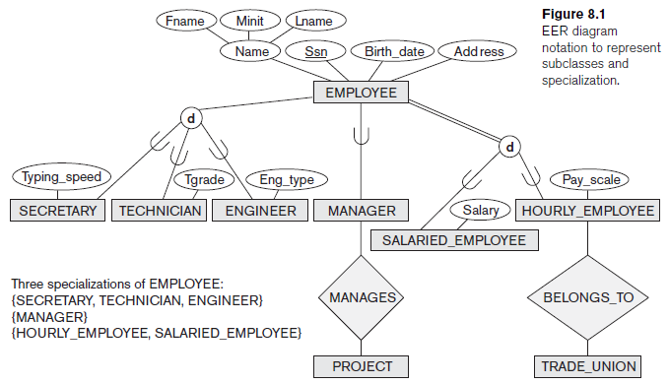

Slide 6
Enhance ERD
The most important modeling construct incorporated in the EER model is supertype/subtype relationships.
This facility enables us to model a general entity type (called the supertype) and then subdivide it into several specialized entity types (called subtypes).
For Example:
The entity type EMPLOYEE can be modeled as a supertype, with subtypes TECHNICIAN, SECERATRY, ENGINEER and MANAGER.
Each subtype inherits attributes from its supertype and in addition may have special attributes and be involved in relationships of its own

Slide 7
Super Type subtype relationship
Supertype: A generic entity type that has a relationship with one or more subtypes
  An entity type that includes one or more distinct subgroups which require to be represented in a data model.
Subtype: A subgrouping of the entities in an entity type that is meaning full to the organization and that share common attributes distinct from those in other subgroupings
Attribute Inheritance:
  Subtype entities inherit values of all attributes of the supertype
  An instance of a subtype is also an instance of the supertype

Slide 8
subtype identifier
Subtypes can be exclusive or inclusive.
  If exclusive, the supertype relates to at most one subtype.
  If inclusive, the supertype can relate to one or more subtypes.
The relationships that connect supertypes and subtypes are called IS-A relationships because a subtype is the same entity as the supertype
The identifier/primary key of a supertype and all of its subtypes is the same attribute

Slide 9
Feature of Subtype
A subtype:
inherits all attributes of the supertype
inherits all relationships of the supertype
usually has its own attributes or relationships
is drawn within the supertype
never exists alone
may have subtypes of its own
is also known as a "subentity“

Slide 10
Notation
The supertype is connected with a line to a circle, which in turn is connected with a line to each subtype that has been defined.
The U-shaped symbol on each line connecting a subtype to the circle emphasizes that the subtype is a subset of the supertype.
It also indicates the direction of the subtype/supertype relationship.

Slide 11
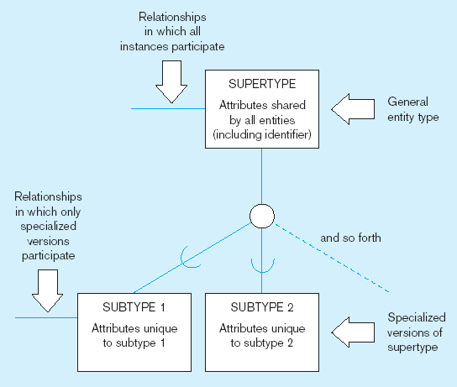

Slide 12
Example
Hourly employees Employee Number, Employee Name, Address, Date Hired, Hourly Rate
Salaried employees Employee Number, Employee Name, Address, Date Hired, Annual Salary, Stock Option
Contract consultants Employee Number, Employee Name, Address, Date Hired, Contract Number, Billing Rate

Slide 13
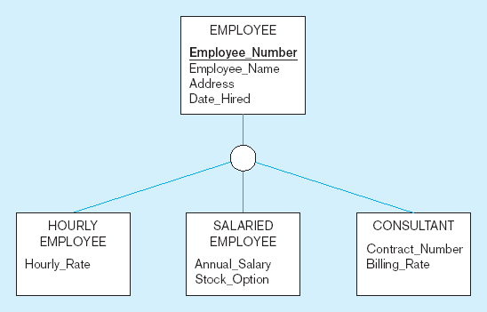
An Example: Employee supertype with hourly, salaried and consultant subtype

Slide 14
An example
Employee is a super type while manager, salesperson and secretary are its sub type.
Employee:
  EID, Ename, Salary, Position, TypingSpeed, ManagerBonus, SalesArea, CarAllowance
Employee:EID, Ename, Salary, Position
  Manager: managerBonus
  SalesPerson: SalesArea, CarAllowance
  Secretary: TypingSpeed

Slide 15
EID
SALARY
NAME
EMPLOYEE
POSITION
MANAGER
SLAESPERSON
SECRETRY
Manager Bonus
Sales Area
Car Allowance
Typing Speed

Slide 16
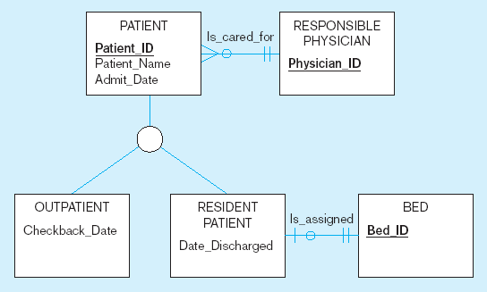
Super type/ Sub type relationship
Relationships at the supertype level indicate that all subtypes will participate in the relationship
The instances of a subtype may participate in a relationship unique to that subtype. In this situation, the relationship is shown at the subtype level

Slide 17
Representing Generalization and Specialization
Generalization : The process of defining a more general entity type from a set of more specialized entity types.
It Bottom Up approach
Specialization: The process of defining one or more subtypes of the supertype and forming supertype/subtype relationships.
It is top down approach

Slide 18
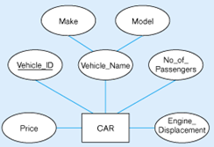
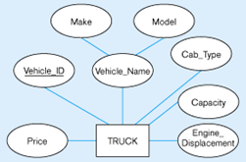
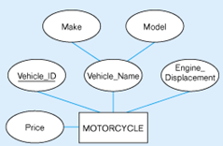
Generalization
Three entity types have been defined:
CAR, TRUCK, and MOTORCYCLE
Three entity types have a number of attributes in common:
Vehicle ID (identifier), Vehicle Name (with components Make and Model),
Price, and Engine Displacement
This fact suggests that each of the three entity types is really a version of a more general entity type called Vehicle

Slide 19
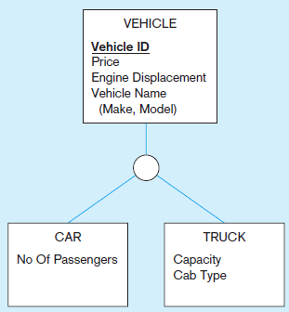
Generalization
The specific attributes of each entity are
CAR ( No Of Passengers)
TRUCK (Capacity , Cab Type)
Generalization has allowed us to group entity types along with their common attributes and at the same time preserve specific attributes that are peculiar to each subtype.
The entity type MOTORCYCLE is not included in the relationship.
MOTORCYCLE fas all those attributes that are common to all vehicles;
There are no attributes specific to motorcycles.

Slide 20
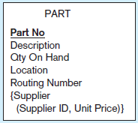
Specialization
Part Example
Part have the following attributes
PART( Part No, Description, Unit Price, Location, Qty On Hand, Routing Number)
In specialization, the general entity PART
can be subdivide into manufacturer part and Purchase part
Thus super type is PART and its subtypes are manufacturer and purchased part

Slide 21
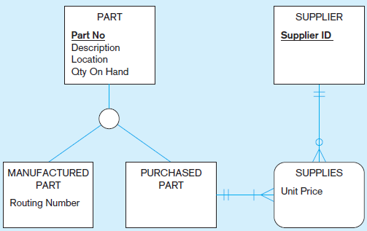
Specialization

Slide 22
When to use Generalization and specialization
Specialization and generalization are both valuable techniques for developing supertype/subtype relationships.
The technique you use at a particular time depends on several factors
The nature of the problem domain
previous modeling efforts
Personal preference

Slide 23
Constraints on Super type sub type relationship
Completeness constraint A type of constraint that addresses whether an instance of a supertype must also be a member of at least one subtype.
It has two types
Total specialization rule: A rule that specifies that each entity instance of a supertype must be a member of some subtype in the relationship.
Partial specialization rule
A rule that specifies that an entity instance of a supertype is allowed not to belong to any subtype.

Slide 24
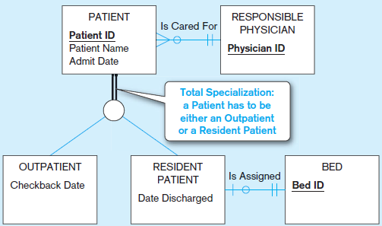
Total specialization
A patient must be either an outpatient or a resident patient. Total specialization is indicated by the double line extending from the PATIENT entity type to the circle.
In this example, every time a new instance of PATIENT is inserted into the super type, a corresponding instanceis inserted
into either OUTPATIENT or RESIDENT PATIENT.
If the instance is inserted into RESIDENT PATIENT,
an instance of the relationship” “Is Assigned is”
created to assign the patient to a hospital bed

Slide 25
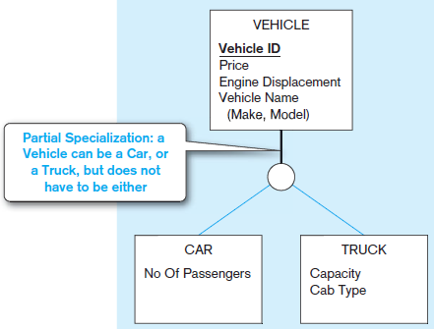
Partial specialization
A Motorcycle is a type of vehicle, but it is not represented
as a subtype in the data model.
Thus, if a vehicle is a car, it must appear as an instance
of CAR,
If it is a truck, it must appear as an instance of TRUCK.
If the vehicle is a motorcycle, it cannot appear as
an instance of any subtype.
Partial specialization is specified by the single line from
the VEHICLE supertype to the circle.

Slide 26
Constraints on Super type sub type relationship
Specifying Disjointness Constraints
A disjointness constraint addresses whether an instance of a supertype may simultaneously be a member of two (or more) subtypes.
The disjointness constraint has two possible rules:
Disjoint rule
overlap rule.
The disjoint rule specifies that if an entity instance (of the supertype) is a member of one subtype, it cannot simultaneously be a member of any other subtype.
The overlap rule specifies that an entity instance can simultaneously be a member of two (or more) subtypes

Slide 27
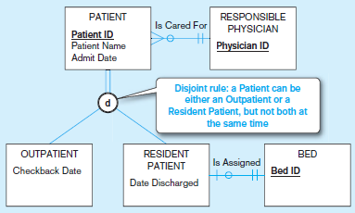
Disjoint rule
At any given time, a patient must be either an outpatient or a resident patient, but cannot be both.
The disjoint rule is specified by the letter d in the circle joining the supertype and its subtypes.
Note in this figure, the subclass of a PATIENT
may change over time, but at a given time,
a PATIENT is of only one type.

Slide 28
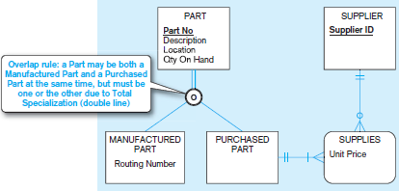
Overlap rule
The entity type PART with its two subtypes, MANUFACTURED PART and PURCHASED PART
Some parts are both manufactured and purchased
For example, consider part number 4000. At a given time, the quantity on hand for this part might be 250, of which 100 are manufactured and the remaining 150 are purchased parts.
The overlap rule is specified by placing
the letter o in the circle
the total specialization rule is also
specified, as indicated by the double
line. Thus, any part must be either
a purchased part or a manufactured
part, or it may simultaneously be both of
these.

Slide 29
CASE Study 2
.At a weekend retreat, the entity type PERSON has three subtypes: CAMPER, BIKER, and RUNNER
Draw a separate EER diagram segment for each of the following situations:
At a given time, a person must be exactly one of these subtypes
A person may or may not be one of these subtypes. However, a person who is one of these subtypes cannot at the same time be one of the other subtypes
A person may or may not be one of these subtypes. On the other hand, a person may be any two (or even three) of these subtypes at the same time
At a given time, a person must be at least one of these subtypes.

Slide 30
CASE Study 1
Consultant There are two types of
consultants: business consultants and technical consultants. Business consultants are contacted by a business in order to first determine security needs and provide an estimate for the actual services to be performed. Technical consultants perform services according to the specifications developed by the business consultants.
Attributes of business consultant are the following: Employee ID (identifier), Name, Address (which is composed of Street, City, State, and Zip Code), Telephone, Date Of Birth, Age, Business Experience (which is composed of Number of Years, Type of Business [or businesses], and Degrees Received). Attributes of technical consultant are the following: Employee ID (identifier), Name, Address (which is composed of Street, City, State, and Zip Code), Telephone, Date Of Birth, Age, Technical Skills, and Degrees Received.

Slide 31
CASE Study 1
Customer Customers are businesses that have asked for consulting services. Attributes of customer are Customer ID (identifier), Company Name, Address (which is composed of Street, City, State, and Zip Code), Contact Name, Contact Title, Contact Telephone, Business Type, and Number Of Employees.
Customers can have multiple locations. Attributes of location are Customer ID (identifier), Location ID (which is unique only for each Customer ID), Address (which is composed of Street, City, State, and Zip Code), Telephone, and Building Size.
A security service is performed for a customer at one or more locations. Before services are performed, an estimate is prepared. Attributes of service are Service ID (identifier), Description, Cost, Coverage, and Clearance Required. Additional Business Rule

Slide 32
Additional Business Rules In addition to the entities outlined previously, the following information will need to be stored to tables and should be shown in the model. These may be entities, but they also reflect a relationship between more than one entity: • Estimates, which have characteristics of Date, Amount, Business Consultant, Services, and Customer • Services Performed, which have characteristics of Date, Amount, Technical Consultant, Services, and Customer In order to construct the EER diagram, you may assume the following: A customer can have many consultants providing many services. You wish to track both actual services performed as well as services offered. Therefore, there should be two relationships between customer, service, and consultant, one to show services performed and one to show services offered as part of the estimate. 18. Based on the EER diagram construct

Slide 33
Class task
Draw an EER diagram for the following description of a law firm: Each case handled by the firm has a unique case number; a date opened, date closed, and judgment description is also kept on each case. A case is brought by one or more plaintiffs, and the same plaintiff may be involved in many cases. A plaintiff has a requested judgment characteristic. A case is against one or more defendants and the same defendant may be involved in many cases. A plaintiff or defendant may be a person or an organization. Over time, the same person or organization may be a defendant or a plaintiff in cases. In either situation, such legal entities are identified by an entity number, and other attributes are name and net worth.

Slide 34
Class task
Draw an EER diagram for the following problem
A nonprofit organization depends on a number of different types of persons for its successful operation. The organization is interested in the following attributes for all of these persons: SSN, Name, Address, City/State/Zip, and Telephone
Three types of persons are of greatest interest: employees, volunteers, and donors. Employees have only a Date Hired attribute, and volunteers have only a Skill attribute. Donors have only a relationship (named Donates) with an Item entity type
A donor must have donated one or more items, and an item may have no donors, or one or more donors
There are persons other than employees, volunteers, and donors who are of interest to the organization, so that a person need not belong to any of these three groups
On the other hand, at a given time a person may belong to two or more of these groups (e.g., employee and donor).

